Slide 1
ISS internal multiple attenuation algorithm for a 3-D source and a one-dimensional subsurface
Xinglu Lin* and Arthur B. Weglein
May 29th, 2014
Austin, TX
Notes:
1
1

Slide 2
Outline
Motivation;
Reduced form of 3-D ISS internal multiple attenuator for a 1-D layered earth:
Circular symmetry;
3-D source ISS internal multiple attenuator for a 1-D earth;
Numerical test;
Conclusions.

Slide 3
Outline
Motivation;
Reduced form of 3-D ISS internal multiple attenuator for a 1-D layered earth:
Circular symmetry;
3-D source ISS internal multiple attenuator for a 1-D earth;
Numerical test;
Conclusions.

Slide 4
Motivation
There are on-shore and off-shore regions, which are close to 1-D earth and have serious internal multiple problems. For example, Central North sea (B. Duquet, 2013), Canada, offshore Brazil and Middle East.
When the earth is close to 1-D, we do not have to pay for a “complete” data set and high computation as in 3-D earth by using the reduced 3-D source-1-D earth algorithm;
3-D source－1-D earth ISS internal multiple attenuator is needed for the ISS eliminator of internal multiple.

Slide 5
Motivation - Current state of ISS internal multiple attenuator
2-D Line Source:
2-D algorithm assume that whole world is 2-D. A point source in the 2-D world is a line in a 3-D world.
2-D source-1-D earth: The algorithm is derived from 2-D source, which is a reduced form for a 1-D earth. It requires one source and receivers on one single line.
(Araujo, et al,1994; Weglein, et al,1997)
code released by P. Terenghi; S. Kaplan;
Application: Qiang Fu, Encana data, 2014 M-OSRP annual report

Slide 6
Motivation - Current state of ISS internal multiple attenuator
3-D Point Source:
In 3-D theory the world is considered as 3-D. Source is a point in a 3-D world.
3-D Source-3-D Earth
3-D Source-2-D Earth
3-D Source-1-D Earth (in Cartesian Coordinates)
3-D Source-1-D Earth (in Cylindrical Coordinates)

Slide 7
Requirements of 3-D ISS internal multiple attenuator
3-D Source-3-D Earth
3-D Source-2-D Earth
3-D Source-1-D Earth (in Cartesian Coordinates)
3-D Source-1-D Earth (in Cylindrical Coordinates)

Slide 8
3-D Source-3-D Earth
X-direction
Source
Receiver
Z
Y
X
Requirements: Areal coverage of sources; Areal coverage of receivers.

Slide 9
3-D Source-3-D Earth
X-direction
Source
Receiver
Z
Y
X
Requirements: Areal coverage of sources; Areal coverage of receivers.

Slide 10
3-D Source-3-D Earth
X-direction
Source
Receiver
Z
Y
X
Requirements: Areal coverage of sources; Areal coverage of receivers.

Slide 11
3-D Source-3-D Earth
X-direction
Source
Receiver
Z
Y
X
Requirements: Areal coverage of sources; Areal coverage of receivers.

Slide 12
3-D Source-3-D Earth
X-direction
Source
Receiver
Z
Y
X
Requirements: Areal coverage of sources; Areal coverage of receivers.

Slide 13
3-D Source-3-D Earth
X-direction
Source
Receiver
Z
Y
X
Requirements: Areal coverage of sources; Areal coverage of receivers.

Slide 14
3-D Source-3-D Earth
Y-direction
Source
Receiver
Z
Y
X
Requirements: Areal coverage of sources; Areal coverage of receivers.

Slide 15
3-D Source-3-D Earth
Y-direction
Source
Receiver
Z
Y
X
Requirements: Areal coverage of sources; Areal coverage of receivers.

Slide 16
3-D Source-3-D Earth
Y-direction
Source
Receiver
Z
Y
X
Requirements: Areal coverage of sources; Areal coverage of receivers.

Slide 17
3-D Source-3-D Earth
Y-direction
Source
Receiver
Z
Y
X
Requirements: Areal coverage of sources; Areal coverage of receivers.

Slide 18
3-D Source-3-D Earth
Y-direction
Source
Receiver
Z
Y
X
Requirements: Areal coverage of sources; Areal coverage of receivers.

Slide 19
3-D Source-3-D Earth
Y-direction
Source
Receiver
Z
Y
X
Requirements: Areal coverage of sources; Areal coverage of receivers.

Slide 20
3-D Source-3-D Earth
Source
Receiver
Z
Y
X
Requirements: Areal coverage of sources; Areal coverage of receivers.

Slide 21
Requirements of 3-D ISS internal multiple attenuator
3-D Source-3-D Earth
3-D Source-2-D Earth
3-D Source-1-D Earth (in Cartesian Coordinates)
3-D Source-1-D Earth (in Cylindrical Coordinates)

Slide 22
3-D Source-2-D Earth
Source
Receiver
Z
Y
X
Requirements: Sources on a single line (x-direction); Areal coverage of receivers.

Slide 23
3-D Source-2-D Earth
Source
Receiver
Z
Y
X
Requirements: Sources on a single line (x-direction); Areal coverage of receivers.

Slide 24
3-D Source-2-D Earth
Source
Receiver
Z
Y
X
Requirements: Sources on a single line (x-direction); Areal coverage of receivers.

Slide 25
3-D Source-2-D Earth
Source
Receiver
Z
Y
X
Requirements: Sources on a single line (x-direction); Areal coverage of receivers.

Slide 26
3-D Source-2-D Earth
Source
Receiver
Z
Y
X
Requirements: Sources on a single line (x-direction); Areal coverage of receivers.

Slide 27
3-D Source-2-D Earth
Source
Receiver
Z
Y
X
Requirements: Sources on a single line (x-direction); Areal coverage of receivers.

Slide 28
3-D Source-2-D Earth
Source
Receiver
Z
Y
X
Requirements: Sources on a single line (x-direction); Areal coverage of receivers.

Slide 29
3-D Source-2-D Earth
Source
Receiver
Z
Y
X
Requirements: Sources on a single line (x-direction); Areal coverage of receivers.
Notes:
Source line is perpendicular to the direction on which the property doesn’t vary.

Slide 30
Requirements of 3-D ISS internal multiple attenuator
3-D Source-3-D Earth
3-D Source-2-D Earth
3-D Source-1-D Earth (in Cartesian Coordinates)
3-D Source-1-D Earth (in Cylindrical Coordinates)

Slide 31
3-D Source-1-D Earth (Cartesian Coordinates)
Source
Receiver
Z
Y
X
Requirements: One single source; Areal coverage of receivers.
Notes:
In Cartesian coordinates, even for a 1-D earth, the requirement of the areal coverage remains in order to obtain the kx and ky of receivers.

Slide 32
Requirements of 3-D ISS internal multiple attenuator
3-D Source-3-D Earth
3-D Source-2-D Earth
3-D Source-1-D Earth (in Cartesian Coordinates)
3-D Source-1-D Earth (in Cylindrical Coordinates)

Slide 33
3-D Source-1-D Earth (Cylindrical Coordinates)
Source
Receiver
Z
Y
X
Requirements: One single source; Receivers on one single line.

Slide 34
3-D Source-1-D Earth (Cylindrical Coordinates)
Source
Receiver
Z
Y
X
Requirements: One single source; Receivers on one single line.
Notes:
This is the 3D source-1D earth, only require the data on the line, we list 1-D earth which is distributed by P. Terenghi and Qiang fu, why we study the 3-D source, because there is a higher and higher bar for the multiple removal, The adaptive method cannot deal with the interfering of the events.

Slide 35
Motivation - Current state of ISS internal multiple attenuator
3-D Point Source:
1-D earth-3-D source: Current algorithm requires a shot record with areal coverage of receivers (all the x_{g} and y_{g}) for a fixed source (x_{s}, y_{s}).
In this presentation, the ISS internal multiple attenuator will be changed into cylindrical coordinates for a 3-D source and a 1-D earth, which allows a single source and receivers on a single line, rather than a full surface of receivers.

Slide 36
Motivation
This presentation will examine what difference the 3-D source attenuation algorithm makes versus current 2-D line source algorithm for a data generated by a 3-D source and a 1-D earth.
The difference will be amplified when the attenuator b₃ enters the elimination algorithm, e.g., that Yanglei Zou and Dr. Weglein are developing.
The ISS internal multiple eliminator is an important step in the three-pronged strategy.

Slide 37
M-OSRP The three-pronged strategy
Preprocessing for on-shore applications.
Beyond the ISS internal multiple attenuator.
elimination:
Start the ISS internal multiple attenuator for a 3D source - 1D earth at first.
spurious events removal.
New adaptive subtraction criteria.
Notes:
Refer to Jing Wu.

Slide 38
Outline
Motivation;
Reduced form of 3-D ISS internal multiple attenuator for a 1-D layered earth:
Circular symmetry;
3-D source ISS internal multiple attenuator for a 1-D earth;
Numerical test;
Conclusions.

Slide 39
Cylindrical Coordinate
3-D source-1-D earth data only depends on offset and frequency, which has a circular symmetry under cylindrical coordinate (independent of angle).
Notes:
Let me introduce the coordinate before we talk about the symmetry in cylindrical coordinate.

Slide 40
Circular Symmetry
3D-1DE-----3D source, 1-D earth;
Circular symmetry after a two-dimensional Fourier transform or a Fourier-Bessel transform.
Applying the symmetry to b₁ gives a product of and a symmetry factor.

Slide 41
Outline
Motivation;
Reduced form of 3-D ISS internal multiple attenuator for a 1-D layered earth:
Circular symmetry;
3-D source ISS internal multiple attenuator for 1-D earth;
Numerical test;
Conclusions.

Slide 42
3-D ISS internal multiple attenuation algorithm in cylindrical coordinate (1-D earth, k-ω domain)
The circular symmetry produces the simple form, which is reduced from original 3-D ISS attenuation algorithm:
k-ω domain:

Slide 43
3-D ISS internal multiple attenuation algorithm in cylindrical coordinate (1-D earth, Hankel Transform, r-ω (x-ω) domain )
Fourier-Bessel transform over the b₃.
The reduced 3-D algorithm is,
r-ω (x-ω) domain:
Hankel Transform

Slide 44
3-D ISS internal multiple attenuation algorithm for 1-D earth
For example, to deal with a shot record generated by 3-D source-1-D earth, we need to do
3-D source -1-D earth data
Inverse Hankel transform
Or using asymptotic Bessel function
Notes:
Considering the computational costs in Hankel transform, we can use the asymptotic Bessel function to improve the efficiency.

Slide 45
Comparison between 3-D source and 2-D source ISS internal multiple algorithm
Assumption: 1-D earth | (k-ω); | (x-ω)---2-D; (r-ω)---3-D;
2-D line source ISS attenuator |  | Fourier Transform
3-D point source ISS attenuator |  | Hankel Transform
 |  | Asymptotic Bessel

Slide 46
Comments
From the above chart, we can conclude that the 3-D source ISS internal multiple attenuation algorithm remains all its merits for a 1-D earth, since the prediction kernel does not change.

Slide 47
Outline
Motivation;
Reduced form of 3-D ISS internal multiple attenuator for a 1-D layered earth:
Circular symmetry;
3-D source ISS internal multiple attenuator for a 1-D earth;
Numerical test;
Conclusions.

Slide 48
Numerical Test
3-D source
30m
C0=1000m/s, ρ0=1g/cm³
50m
C1=2000m/s,
ρ1=2g/cm³
C2=8000m/s,
ρ2=4g/cm³

Slide 49
Assumptions and 3-D source-1-D earth data
Assumptions:
1-D earth;
3-D source (on streamer, no lateral offset, );
Transform data from spatial-frequency domain to wavenumber-frequency by using Fourier-Bessel transform before multiple prediction.
Data is generated in (k_{rh},q) domain.
( Aki and Richard, Chapter 6)

Slide 50
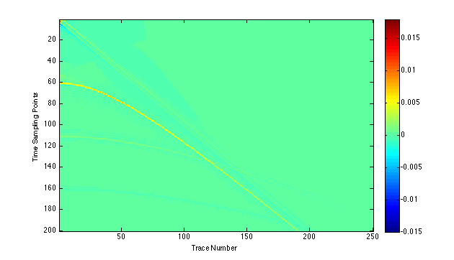
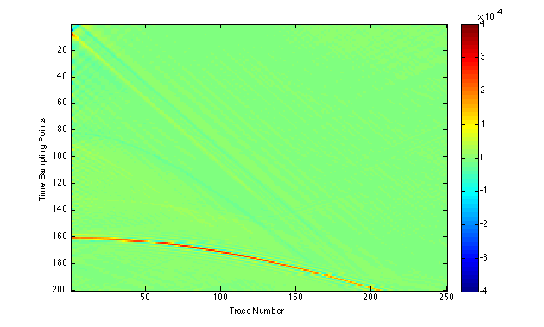
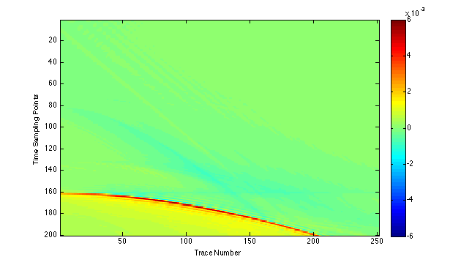
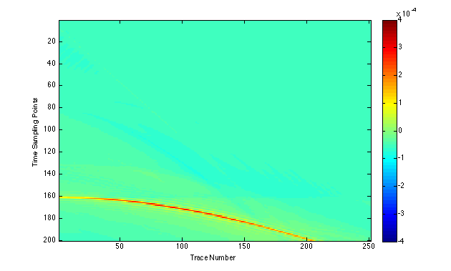
3-D source-1-D earth data, 2-D Prediction, 3-D Prediction with full bandwidth
primary I
primary II
Internal multiple
3-D earth-1-D earth data set (one streamer)
3-D ISS internal multiple prediction
( Hankel transformation)
(courtesy of Yanglei Zou)
2-D ISS internal multiple prediction
3-D ISS internal multiple prediction
(Asymptotic Bessel)

Slide 51
Trace #2: 3-D source-1-D earth data, 3-D prediction and 2-D prediction
Primaries
First-order internal multiple

Slide 52
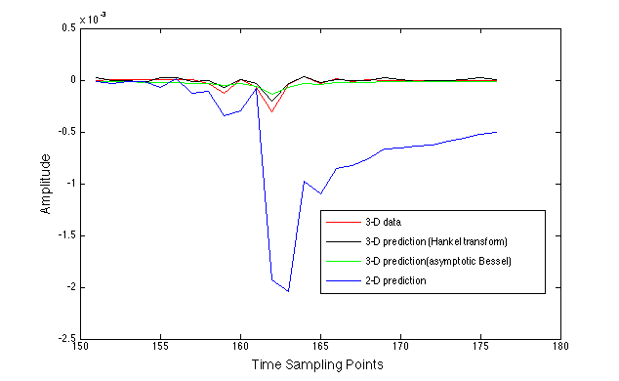
Trace #2: 3-D and 2-D prediction detail with enlarged scale
Primaries
First-order internal multiple

Slide 53
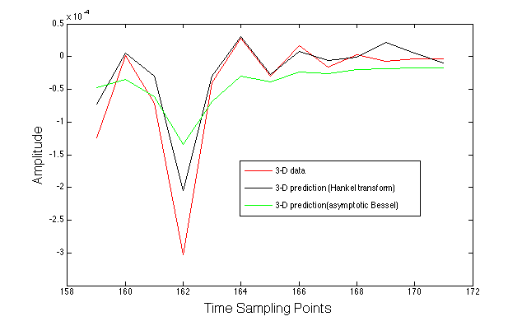
Trace #2: 3-D prediction detail with enlarged scale

Slide 54
Trace #80: 3-D source-1-D earth data, 3-D prediction and 2-D prediction
Primaries
First-order internal multiple

Slide 55
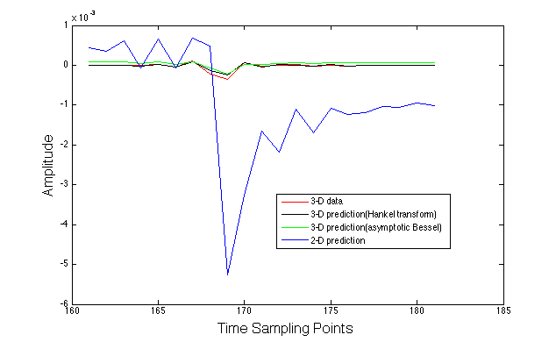
Trace #80: 3-D and 2-D prediction detail with enlarged scale
Primaries
First-order internal multiple

Slide 56
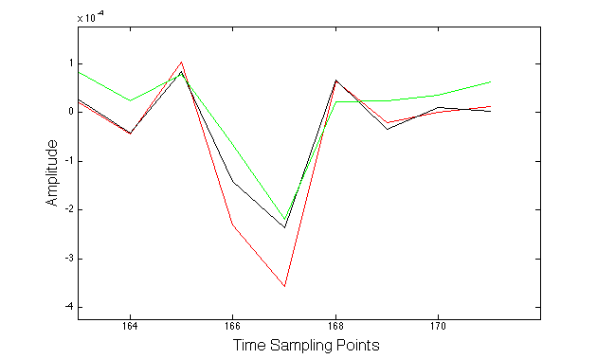
Trace #80: 3-D prediction detail with enlarged scale

Slide 57
Outline
Motivation;
Reduced form of 3-D ISS internal multiple attenuation a algorithm for 1-D layered earth:
Circular symmetry;
3-D source ISS internal multiple attenuator for a 1-D earth;
Numerical test;
Conclusions.

Slide 58
Conclusions
The 3-D ISS Internal multiple attenuation algorithm can be reduced to a simpler form in order to process data that is generated by a 3-D point source and a one-dimensional subsurface. The simple form requires one single source and receivers on one single line, instead of an areal coverage.

Slide 59
Conclusions
This initial test demonstrates that for data from a 3-D source and a 1-D earth, using an ISS internal multiple attenuation algorithm designed for a 2-D source and a 1-D earth could make the multiple problem worse – producing a larger multiple than the original.
The 3-D source, 1-D earth ISS internal multiple attenuator always reduce (attenuates) the internal multiple in data from a 3-D source and a 1-D earth.
This is important to understand/recognize in developing/ applying an ISS internal multiple attenuator on field data where the earth is close to 1-D.

Slide 60
Conclusions
Dr. Terenghi produced several ISS internal multiple codes at M-OSRP. One code reduced a 2-D ISS internal multiple attenuator (a 2-D source, 2-D earth) to a 2-D source and a 1-D earth. The work starts with a 3-D ISS internal multiple attenuator (a 3-D source, 3-D earth) and reduces it to a 3-D source and 1-D earth.
This paper shows that this work represents more than an increase in effectiveness when the data is generated by a 3-D source and a 1-D earth. It changes from “can make matter worse” to “making things better”.

